Slide 1

Bayes’ rule
Notes on Behavioural Economics
Jason Collins

Slide 2
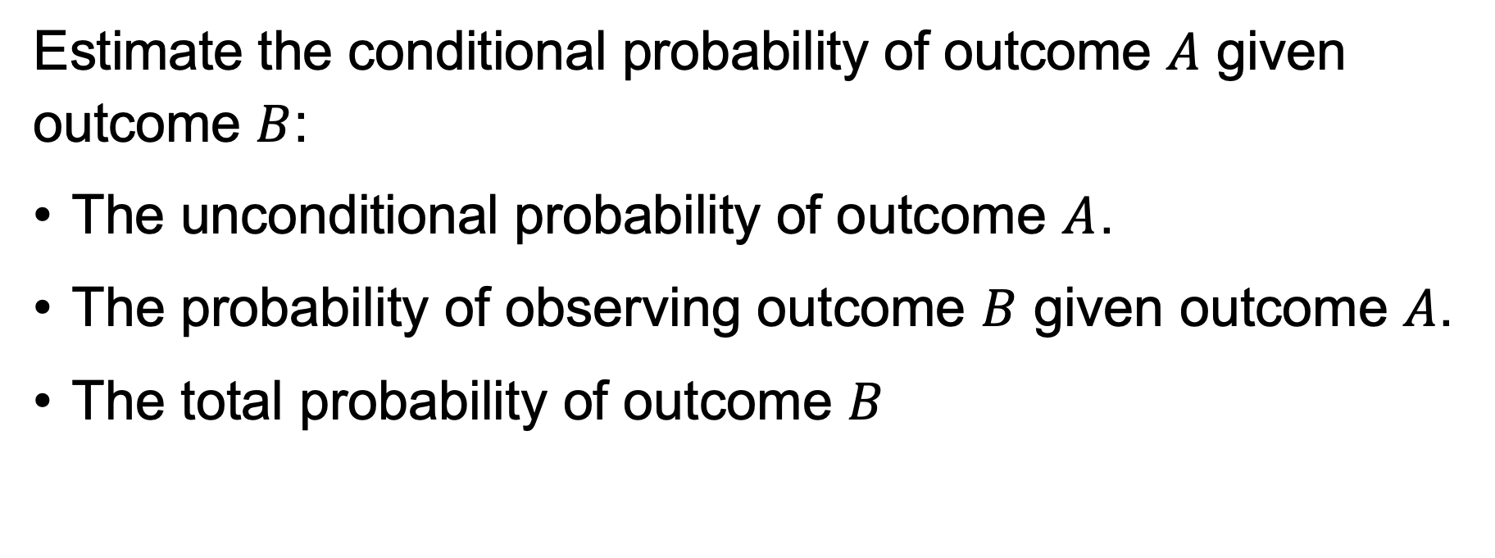
Estimate the conditional probability of outcome $A$ given outcome $B$:
The unconditional probability of outcome $A$.
The probability of observing outcome $B$ given outcome $A$.
The total probability of outcome $B$

Slide 3
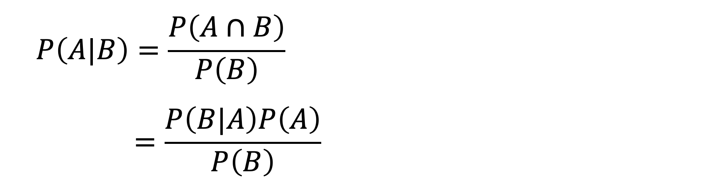
Bayes’ rule
$$P\left(A|B\right)=\frac{P\left(A∩B\right)}{P\left(B\right)}$$
$$=\frac{P\left(B|A\right)P\left(A\right)}{P\left(B\right)}$$

Slide 4
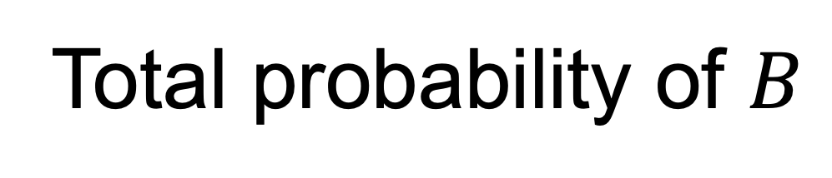
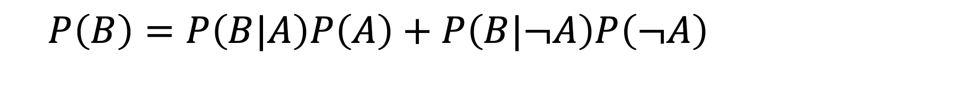
Total probability of $B$
$$P\left(B\right)=P\left(B|A\right)P\left(A\right)+P\left(B|¬A\right)P\left(¬A\right)$$

Slide 5
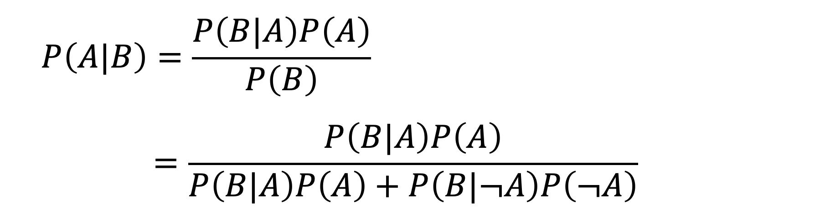
Bayes’ rule
$$P\left(A|B\right)=\frac{P\left(B|A\right)P\left(A\right)}{P\left(B\right)}$$
$$=\frac{P\left(B|A\right)P\left(A\right)}{P\left(B|A\right)P\left(A\right)+P\left(B|¬A\right)P\left(¬A\right)}$$

Slide 6
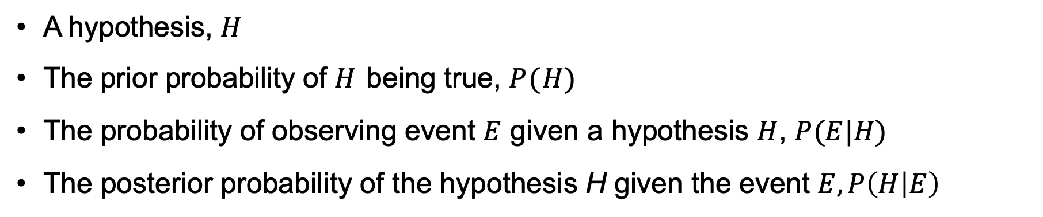
Updating a belief
A hypothesis, $H$
The prior probability of $H$ being true, $P(H)$
The probability of observing event $E$ given a hypothesis $H$, $P(E|H)$
The posterior probability of the hypothesis H given the event $E,P\left(H | E\right)$

Slide 7
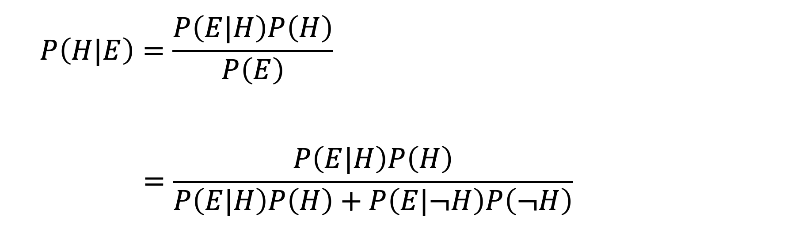
Bayes’ rule
Prior belief
$$P\left(H|E\right)=\frac{P\left(E|H\right)P\left(H\right)}{P\left(E\right)}$$
$$=\frac{P\left(E|H\right)P\left(H\right)}{P\left(E|H\right)P\left(H\right)+P\left(E|¬H\right)P\left(¬H\right)}$$
Posterior belief

Slide 8
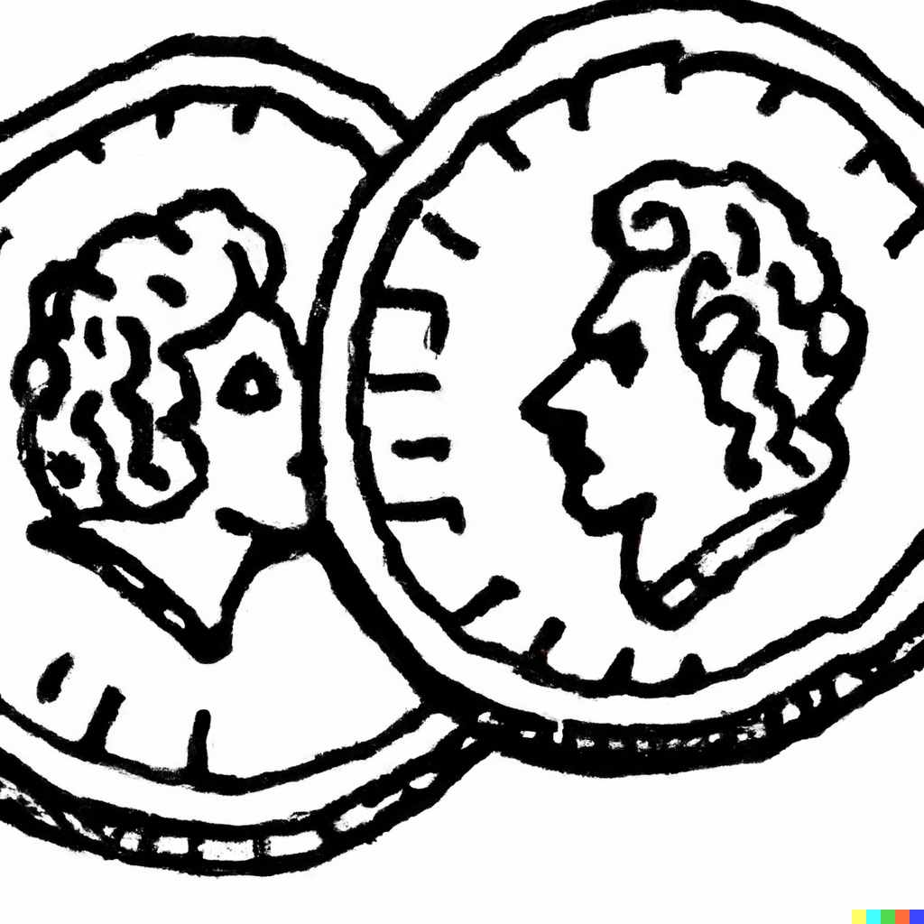

Slide 9
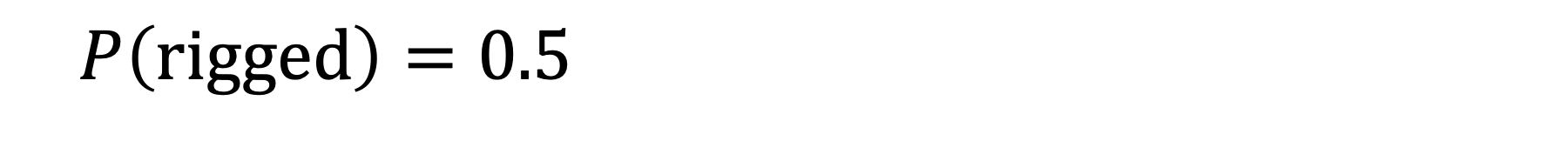
Prior belief
$$P\left(\text{rigged}\right)=0.5$$

Slide 10
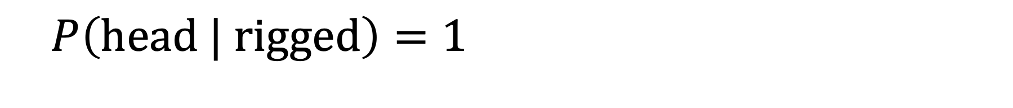
Probability of observing event
$$P\left(\text{head}\text{ | }\text{rigged}\right)=1$$

Slide 11
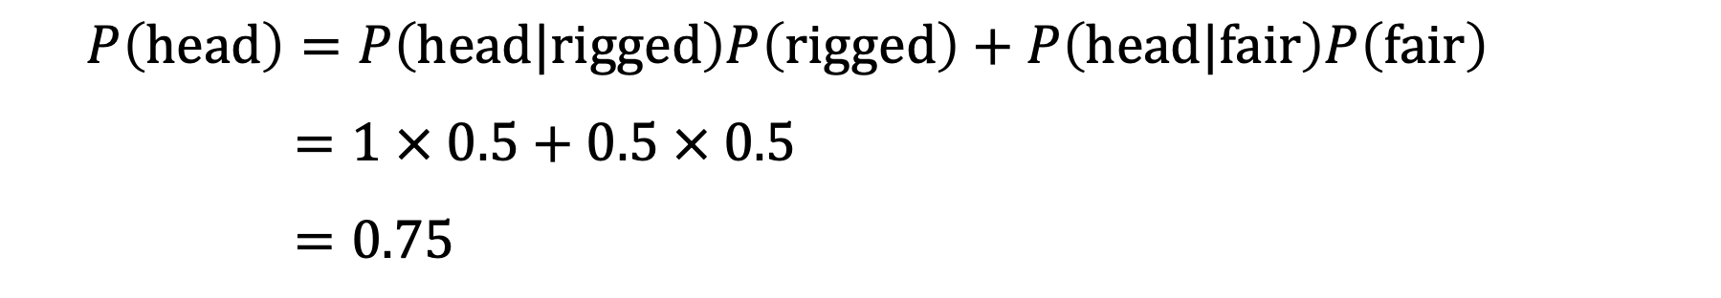
Total probability of a head
$$P\left(\text{head}\right)=P\left(\text{head}\text{|}\text{rigged}\right)P\left(\text{rigged}\right)+P\left(\text{head}\text{|}\text{fair}\right)P\left(\text{fair}\right)$$
$$=1 × 0.5+0.5 × 0.5$$
$$=0.75$$

Slide 12
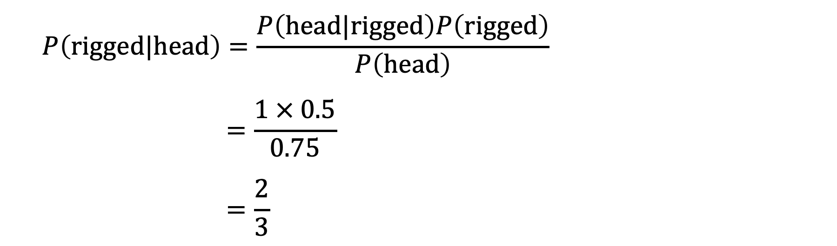
Bayes’ rule
$$P\left(\text{rigged}|\text{head}\right)=\frac{P\left(head|rigged\right)P\left(rigged\right)}{P\left(head\right)}$$
$$=\frac{1 × 0.5}{0.75}$$
$$=\frac{2}{3}$$

Slide 14
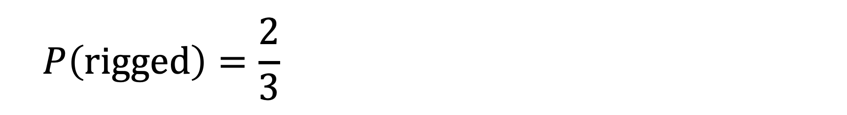
Prior belief
$$P\left(\text{rigged}\right)=\frac{2}{3}$$

Slide 15
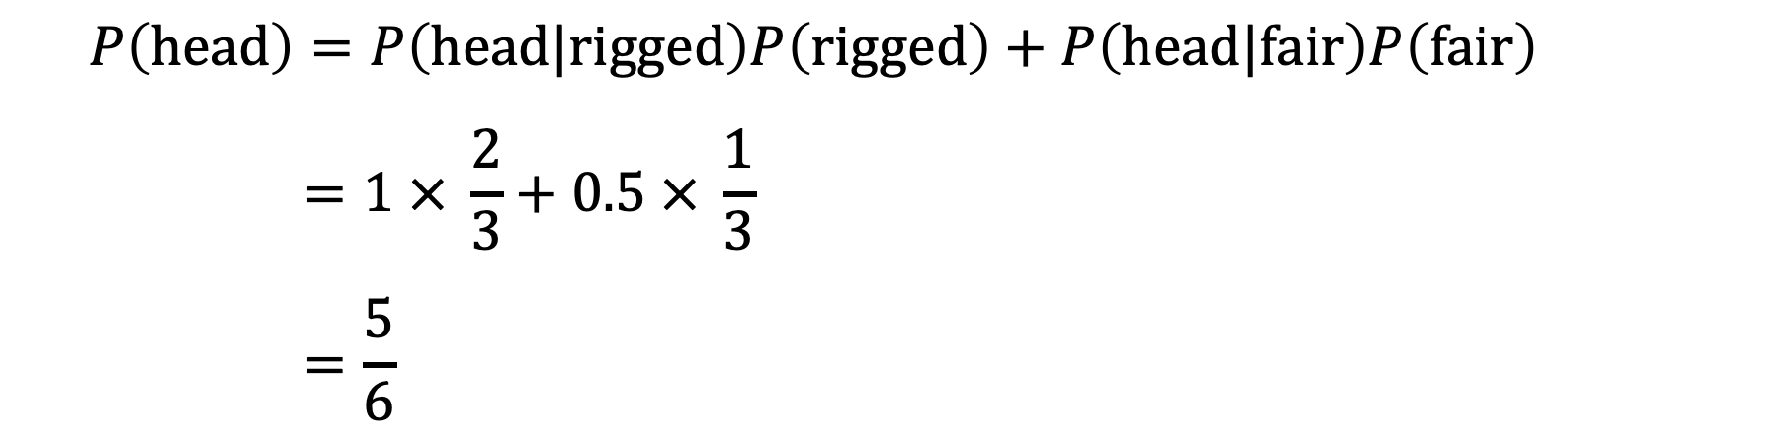
Total probability of a head
$$P\left(\text{head}\right)=P\left(\text{head}\text{|}\text{rigged}\right)P\left(\text{rigged}\right)+P\left(\text{head}\text{|}\text{fair}\right)P\left(\text{fair}\right)$$
$$=1 × \frac{2}{3}+0.5 × \frac{1}{3}$$
$$=\frac{5}{6}$$

Slide 16
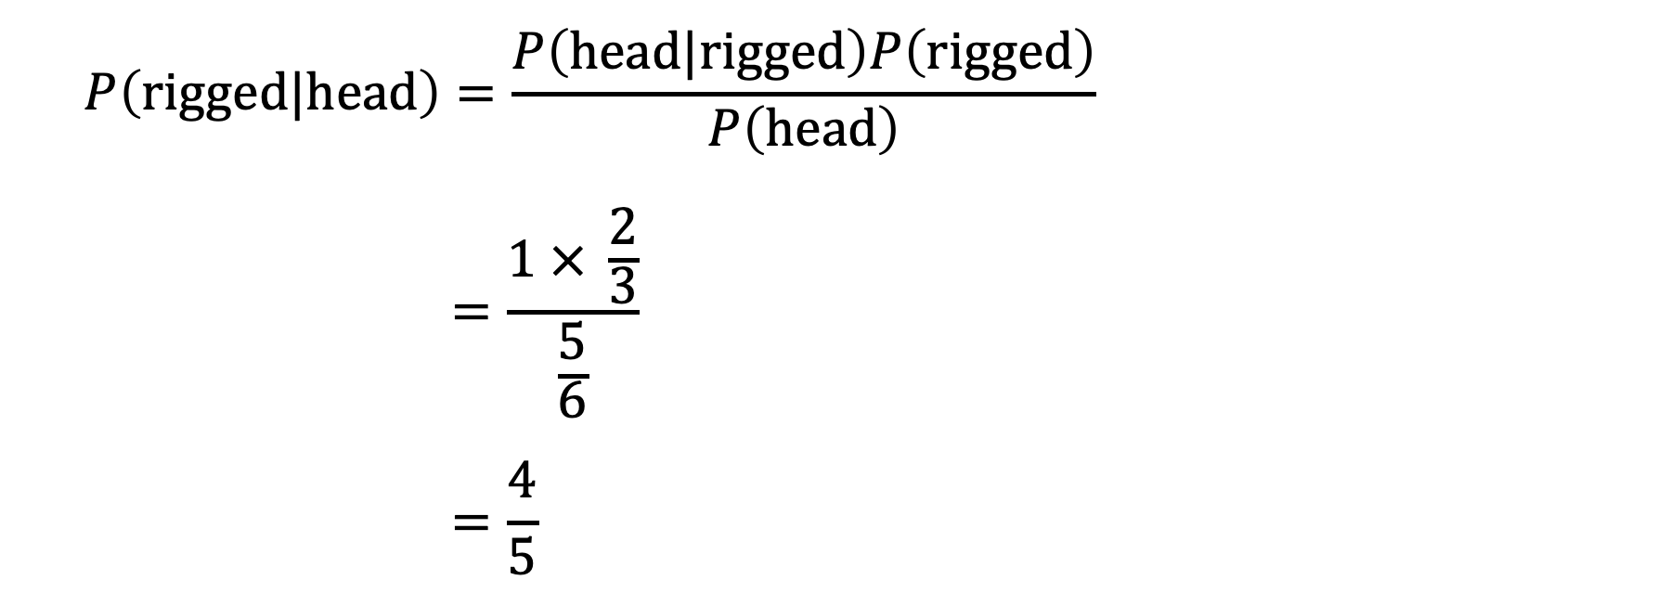
Bayes’ rule
$$P\left(\text{rigged}|\text{head}\right)=\frac{P\left(head|rigged\right)P\left(rigged\right)}{P\left(\text{head}\right)}$$
$$=\frac{1 × \frac{2}{3}}{\frac{5}{6}}$$
$$=\frac{4}{5}$$

Slide 18
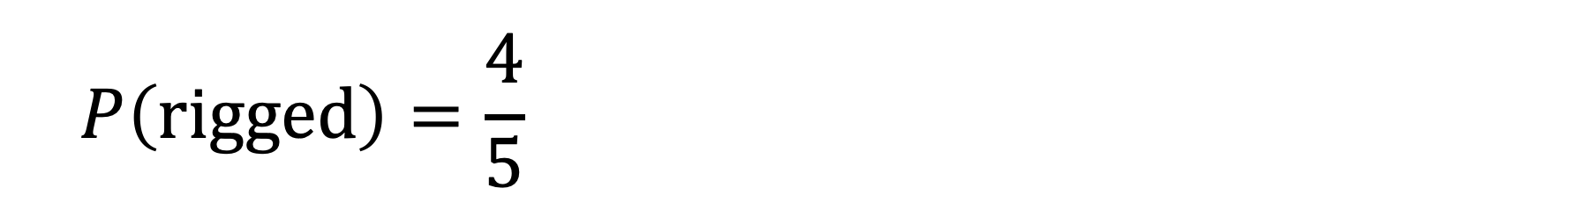
Prior belief
$$P\left(\text{rigged}\right)=\frac{4}{5}$$

Slide 19
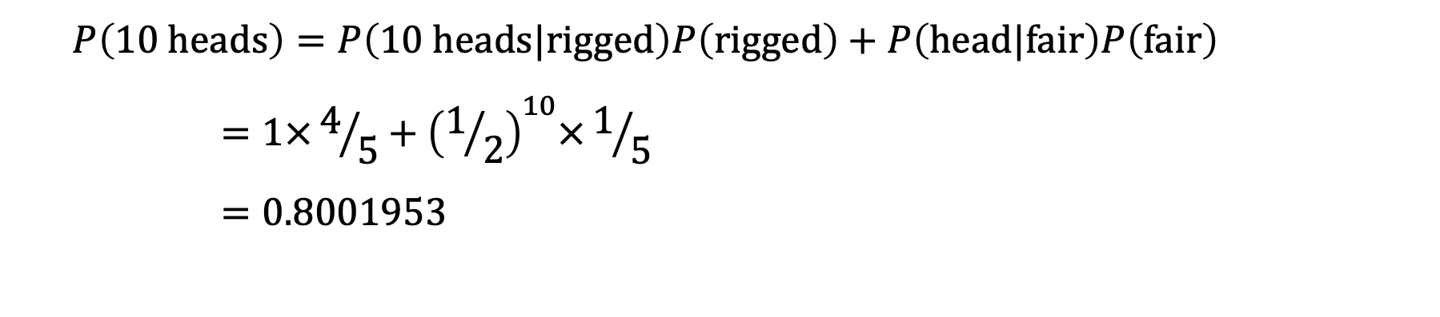
Total probability of 10 heads
$$P\left(10 \text{head}\text{s}\right)=P\left(\text{10 }\text{head}\text{s}\text{|}\text{rigged}\right)P\left(\text{rigged}\right)+P\left(\text{head}\text{|}\text{fair}\right)P\left(\text{fair}\right)$$
$$=1×4/5+{\left(1/2\right)}^{10}×1/5$$
$$=0.8001953$$

Slide 20
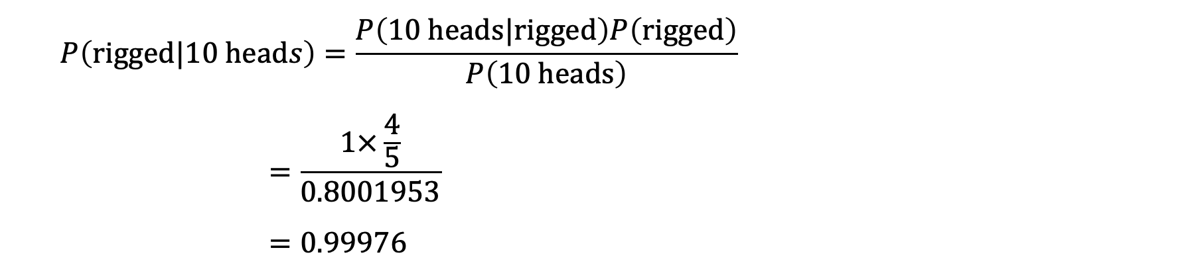
Bayes’ rule
$$P\left(\text{rigged}|\text{10 }\text{head}s\right)=\frac{P\left(10 heads|rigged\right)P\left(rigged\right)}{P\left(\text{10 }\text{heads}\right)}$$
$$=\frac{1×\frac{4}{5}}{0.8001953}$$
$$=0.99976$$

Slide 21


Slide 22
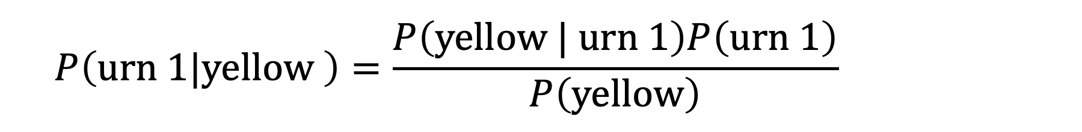
Bayes’ rule
$$P\left(\text{urn}\text{ 1}|\text{yellow} \right)=\frac{P\left(\text{yellow} | \text{urn}\text{ 1}\right)P\left(\text{urn}\text{ 1}\right)}{P\left(\text{yellow}\right)}$$

Slide 23
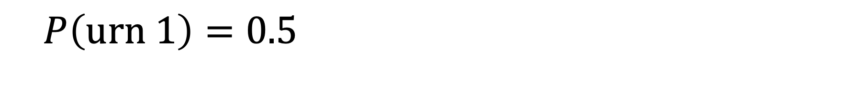
Prior belief
$$P\left(\text{u}\text{r}n 1\right)=0.5$$

Slide 24
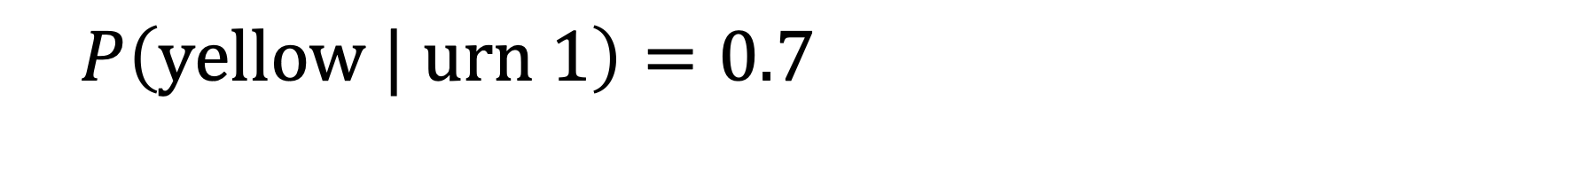
Probability of observing event
$$P\left(\text{yellow}\text{ | }\text{urn}\text{ 1}\right)=0.7$$

Slide 25
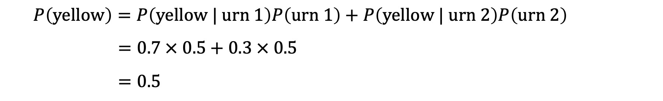
Total probability of yellow ball
$$P\left(\text{yellow}\right)=P\left(\text{yellow} | \text{urn}\text{ 1}\right)P\left(\text{urn}\text{ 1}\right)+P\left(\text{yellow} | \text{urn} 2\right)P\left(\text{urn} 2\right)$$
$$=0.7 × 0.5+0.3 × 0.5$$
$$=0.5$$

Slide 26
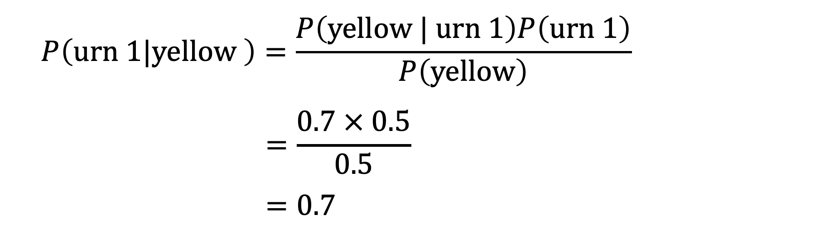
Bayes’ rule
$$P\left(\text{urn}\text{ 1}|\text{yellow} \right)=\frac{P\left(\text{yellow} | \text{urn}\text{ 1}\right)P\left(\text{urn}\text{ 1}\right)}{P\left(\text{yellow}\right)}$$
$$=\frac{0.7 × 0.5}{0.5}$$
$$=0.7$$

Slide 28
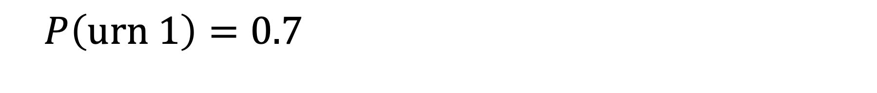
Prior belief
$$P\left(\text{u}\text{r}n 1\right)=0.7$$

Slide 29
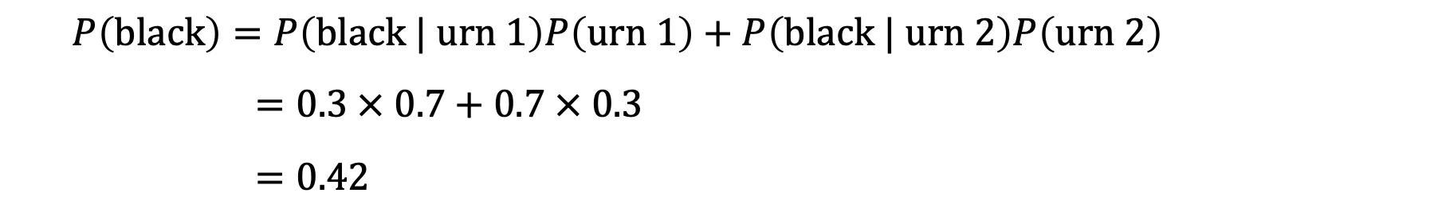
Total probability of black ball
$$P\left(\text{black}\right)=P\left(\text{black} | \text{urn}\text{ 1}\right)P\left(\text{urn}\text{ 1}\right)+P\left(\text{black} | \text{urn} 2\right)P\left(\text{urn} 2\right)$$
$$=0.3 × 0.7+0.7 × 0.3$$
$$=0.42$$

Slide 30
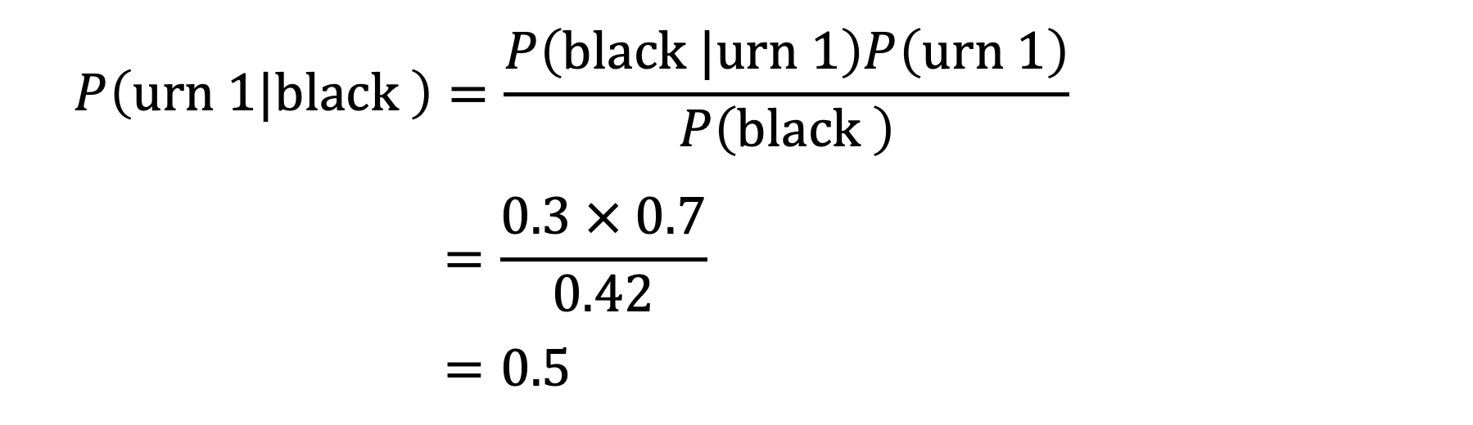
Bayes’ rule
$$P\left(\text{urn}\text{ 1}|\text{black} \right)=\frac{P\left(\text{black} |\text{urn}\text{ 1}\right)P\left(\text{urn}\text{ 1}\right)}{P\left(\text{black} \right)}$$
$$=\frac{0.3 × 0.7}{0.42}$$
$$=0.5$$

Slide 31
The Monty Hall problem
Suppose you’re on a game show and you’re given the choice of three doors: Behind one door is a car; behind the others, goats. You pick a door, say No. 1, and the host, who knows what’s behind the doors, opens another door, say No. 3, which has a goat. He then says to you, “Do you want to pick door No. 2?” Is it to your advantage to switch your choice?

Slide 32
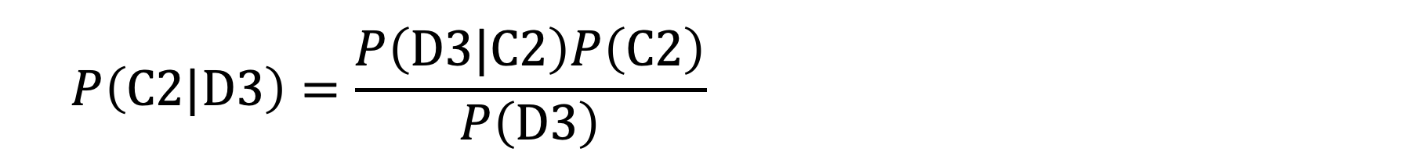
Bayes’ rule
$$P\left(\text{C}\text{2}|\text{D}\text{3}\right)=\frac{P\left(D3|C2\right)P\left(C2\right)}{P\left(D3\right)}$$

Slide 33
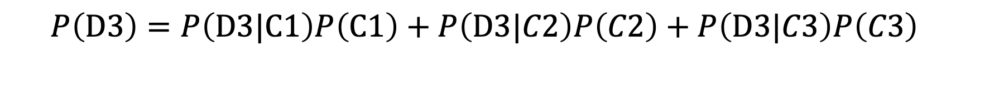
Total probability of D3
$$P\left(\text{D}\text{3}\right)=P\left(D3|C1\right)P\left(C1\right)+P\left(D3|C2\right)P\left(C2\right)+P\left(D3|C3\right)P\left(C3\right)$$

Slide 34
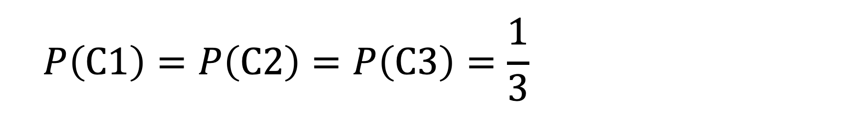
Prior probability
$$P\left(\text{C}\text{1}\right)=P\left(\text{C}2\right)=P\left(\text{C}3\right)=\frac{1}{3}$$

Slide 35
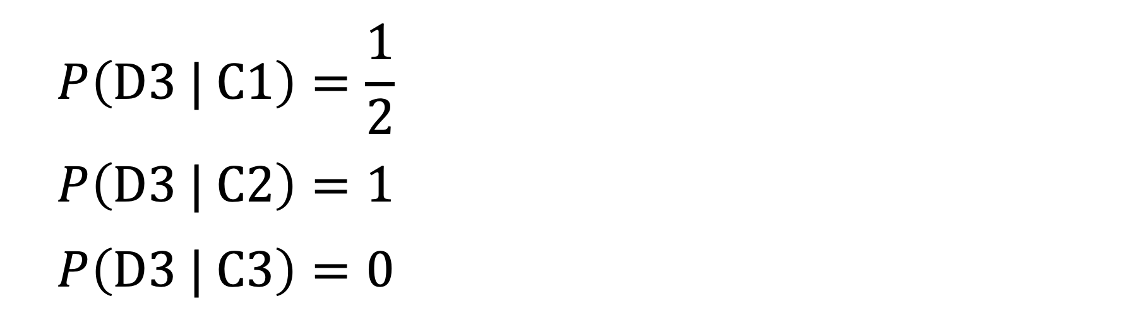
Probability of observing event
$$P\left(\text{D}\text{3 | }\text{C}\text{1}\right)=\frac{1}{2}$$
$$P\left(\text{D}\text{3 | }\text{C}\text{2}\right)=1$$
$$P\left(\text{D}\text{3 | }\text{C}3\right)=0$$

Slide 36
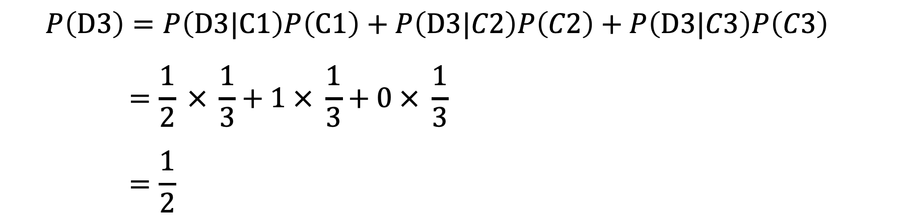
Total probability of D3
$$P\left(\text{D}\text{3}\right)=P\left(D3|C1\right)P\left(C1\right)+P\left(D3|C2\right)P\left(C2\right)+P\left(D3|C3\right)P\left(C3\right)$$
$$=\frac{1}{2} × \frac{1}{3}+1 × \frac{1}{3}+0 × \frac{1}{3}$$
$$=\frac{1}{2}$$

Slide 37
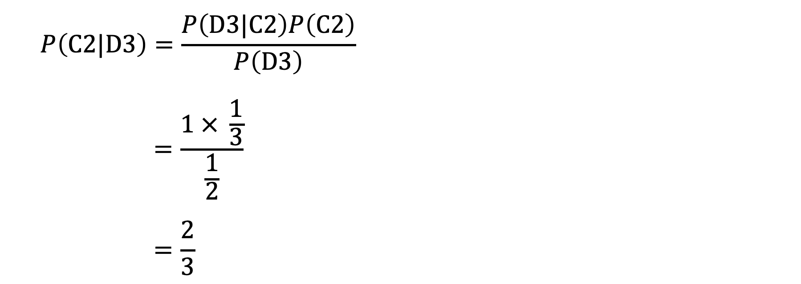
Bayes’ rule
$$P\left(\text{C}\text{2}|\text{D}\text{3}\right)=\frac{P\left(D3|C2\right)P\left(C2\right)}{P\left(D3\right)}$$
$$=\frac{1 × \frac{1}{3}}{\frac{1}{2}}$$
$$=\frac{2}{3}$$

